Slide 1

Presented by: Leoni Hartung & Manolie Bockhöfer
Li-Monti
Collaborate-Comply-Grow
Sustainable Practices for a Cleaner Tomorrow
June, 12 2025

Slide 2
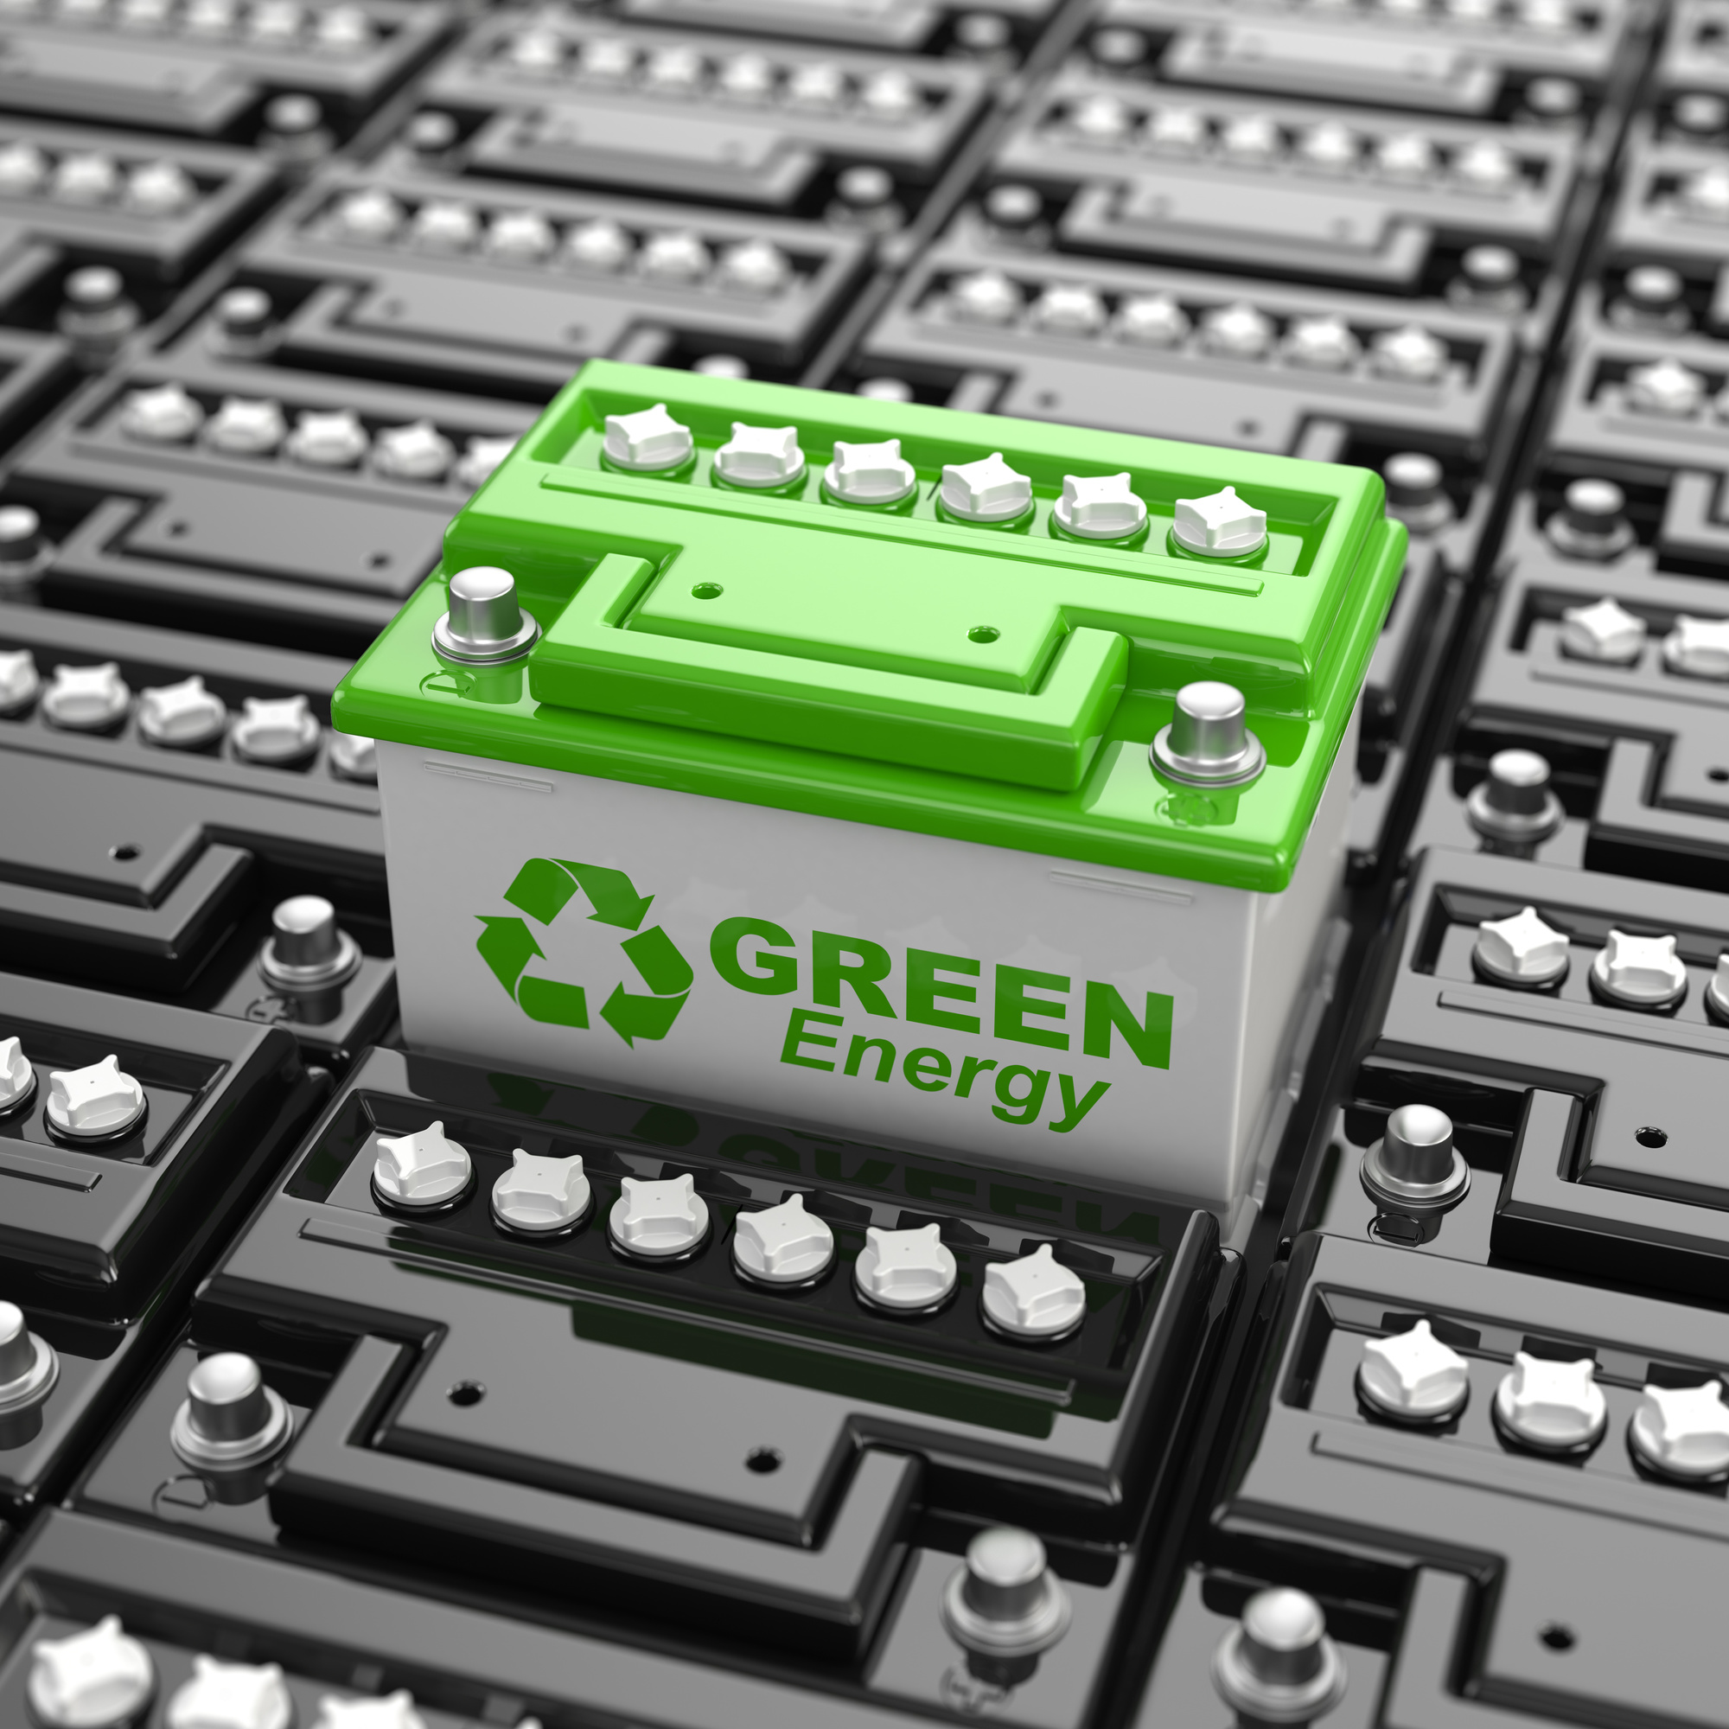
Growing Importance of Battery Recycling
The lithium-ion battery (LIB) market is expanding rapidly due to the energy transition, but this growth brings challenges.
Recycling rates are expected to rise, pushed by political agendas and coming e waste waves ! In the next coming years the need to recycle E-batteries will be higher than ever

Slide 3

Pain Points Identified
01
02
03
04
Fragmentation of the Recycling Value Chain
Low Collection Rates
Compliance Challenges
Lack of Trust
Stakeholders operate in silos; there’s no central hub for coordination.
Citizens lack access to or awareness of nearby drop-off points
Regulations (e.g., EU Battery Regulation) are evolving, and businesses struggle to stay compliant.
SMEs waste time finding trustworthy partners; verification processes are slow or non-existent.

Slide 4

Focus Areas - Our Goal
the need for transparency, trust, and compliance in a fragmented value chain within the LiB recycling sector &
Improve Stakeholder Collaboration
Notes:
We’ve chosen to address fragmentation, compliance support, and trust-building, key levers that unlock circularity and stakeholder collaboration.
Value Proposition

Slide 5













Li-Monti Maps is the 'Google Maps' of battery recycling &more
Our Solution >
We offer an interactive, searchable, and verified map of the LIB value chain with added compliance and community features.
Verified
Anton
Good Experience!
Battery drop of !
Notes:
A Mapping service of the Battery Recycling Value chain

Slide 6



Core Features of our Plattform
Verified Stakeholder Map:
Compliance Support:
News & Updates:
Community & Networking:
Recyclers, drop-off points, logistics providers, manufacturers, searchable by service, compliance, location.
Alerts, checklists, and partnerships with certifiers.
Real-time info on policies, innovations, events.
Forums, DMs, knowledge sharing.

Slide 7






How it works...
Complient
Not Compliant
Chooses our complience support
Acess to be listed on the Map
Gains
Acess after sucessfull service
Trust
Reputation
Potential new Clients
Free Complience Updates for business
Part of building a resilient and Transparent Value Chain
Chooses Individual complience
Acess after proven Complience

Slide 8
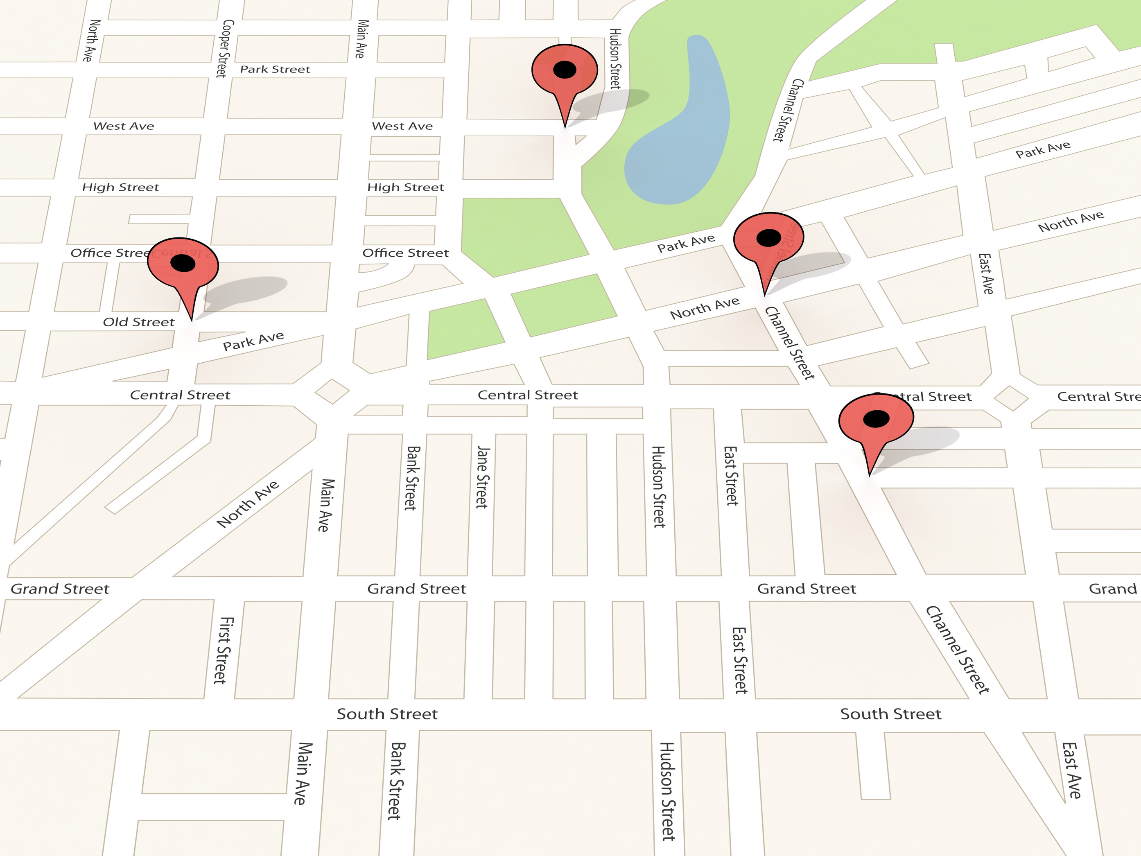
Revenue Streams
1
2
Premium access that allows visibilty on the Map
Complience
services

Slide 9

Impact
For Businesses
Reduced time to find reliable partners.
Easier compliance with EU regulations.
Reduces inequality in sector access->SME´s get visibility
For Citizens
Increased accessibility of battery recycling infrastructure.
Government
Increases visibility of compliant businesses and fulfills political agenda

Slide 10
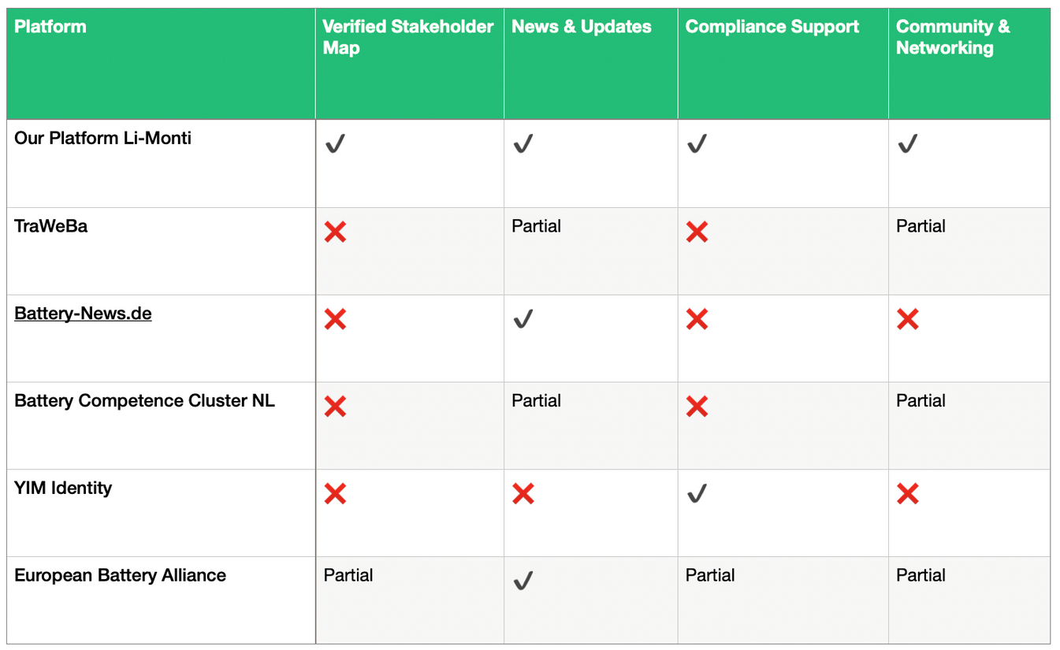
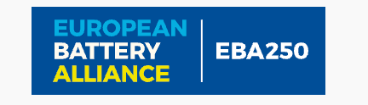




What sets us apart
Our competitiors
Notes:
Unique Selling Proposition (USP)
“The only platform turning battery recycling’s fragmentation into collective advantage, by merging real-time data, matchmaking, and community trust to accelerate profitable circular solutions.”
Justification for USP
Combines verification, community, and compliance no other platform does all three in an interactive way.
People will use it because:
They save time
They meet legal obligations
They find trusted, rated partners

Slide 11










Investment Opportunity

Slide 12
Sources
Cheng, S. (2023, August 8). What Makes a Transparent Li-ion Battery Supply-Chain? Cellcycle. https://www.cellcycle.co.uk/what-makes-a-transparent-li-ion-battery-supply-chain/
Cheng, S. (2025, January 6). A Fresh Look at the Growing Trend of Lithium-ion Battery Recycling in 2025. Cellcycle. https://www.cellcycle.co.uk/a-fresh-look-at-the-growing-trend-of-lithium-ion-battery-recycling-in-2025/
EVBoosters. (2024, August). Europe’s lithium-ion battery recycling: challenges and solutions. EVBoosters. https://evboosters.com/ev-charging-news/europes-lithium-ion-battery-recycling-challenges-and-solutions/
Goyal, H. (2025, March 7). Innovations in lithium-ion battery recycling. Cas.org; CAS. https://www.cas.org/resources/cas-insights/innovations-in-lithium-ion-battery-recycling
Rahnama, H. (2023). Integration of Circular Value Chains and Digitalization: a Focus on Lithium-Ion Battery Material Value Chain. Easychair.org. https://easychair.org/publications/preprint/BcXf3
Schmaltz, Dr. T. (2023, July 26). Europe expands recycling of lithium-ion batteries: Focus on capacity development, demand analysis and market players. Fraunhofer Institute for Systems and Innovation Research ISI. https://www.isi.fraunhofer.de/en/blog/themen/batterie-update/recycling-lithium-ionen-batterien-europa-kapazitaeten-bedarf-akteure-markt-analyse.html

Slide 13
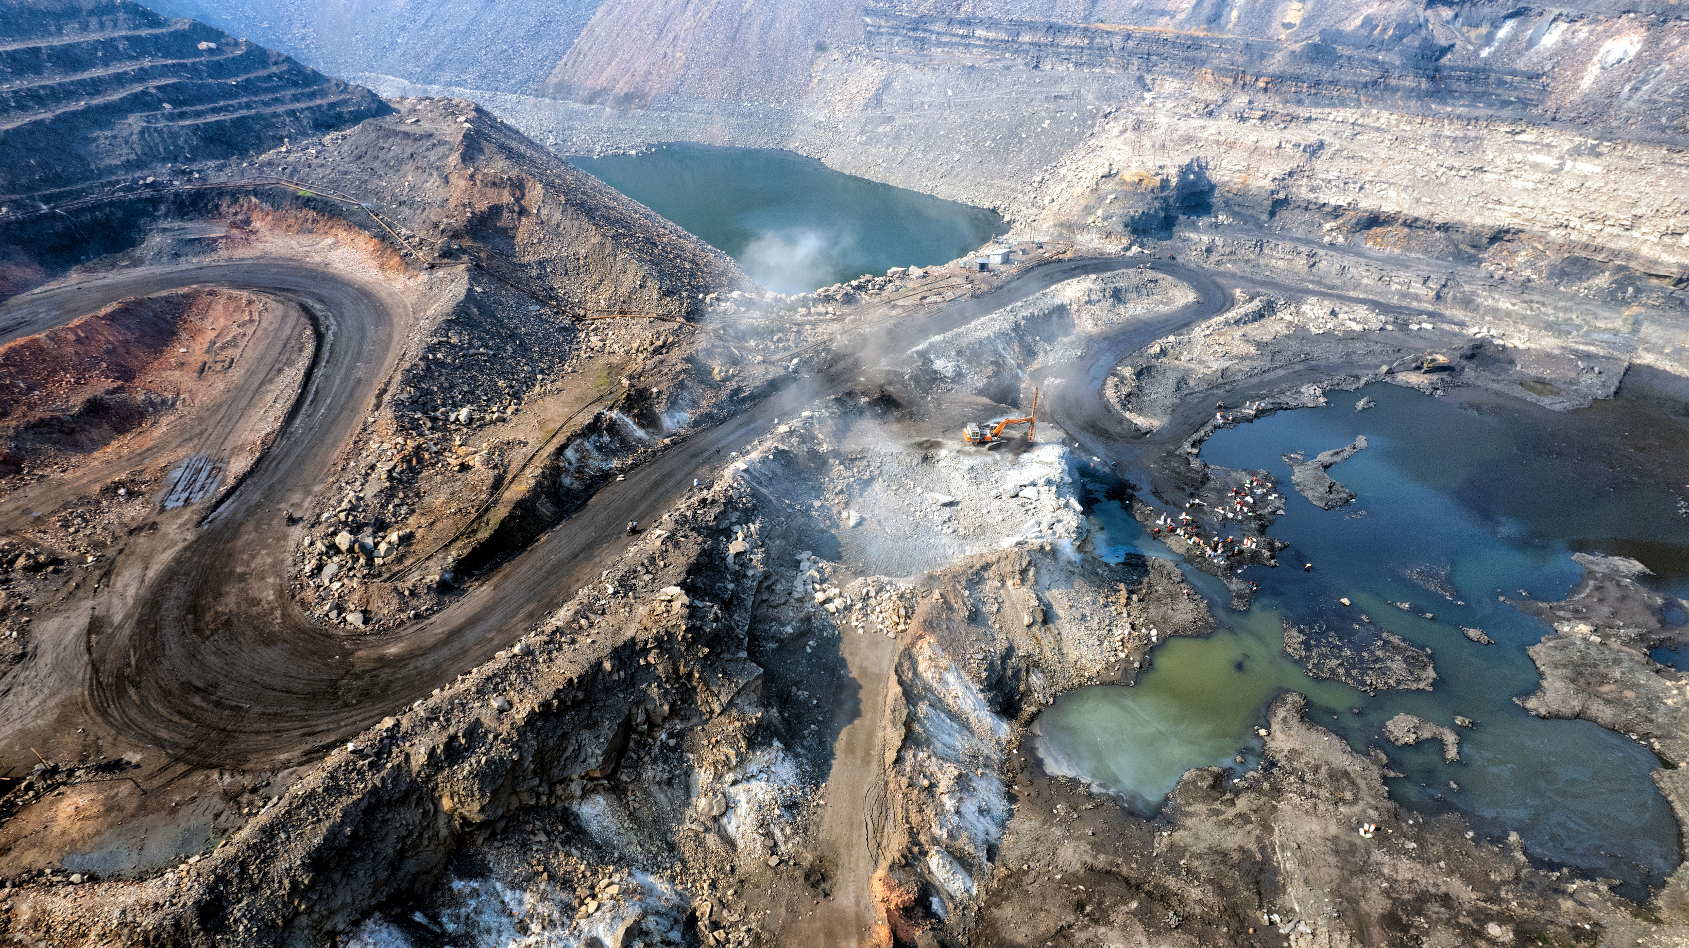
Thank You for Your Attention
Li-Monti Maps creates more than just a map , it builds a transparent, trusted, and collaborative ecosystem that powers the circular battery economy of tomorrow
Lets connect

Slide 14



Q&A
Investment Opportunity

Slide 15
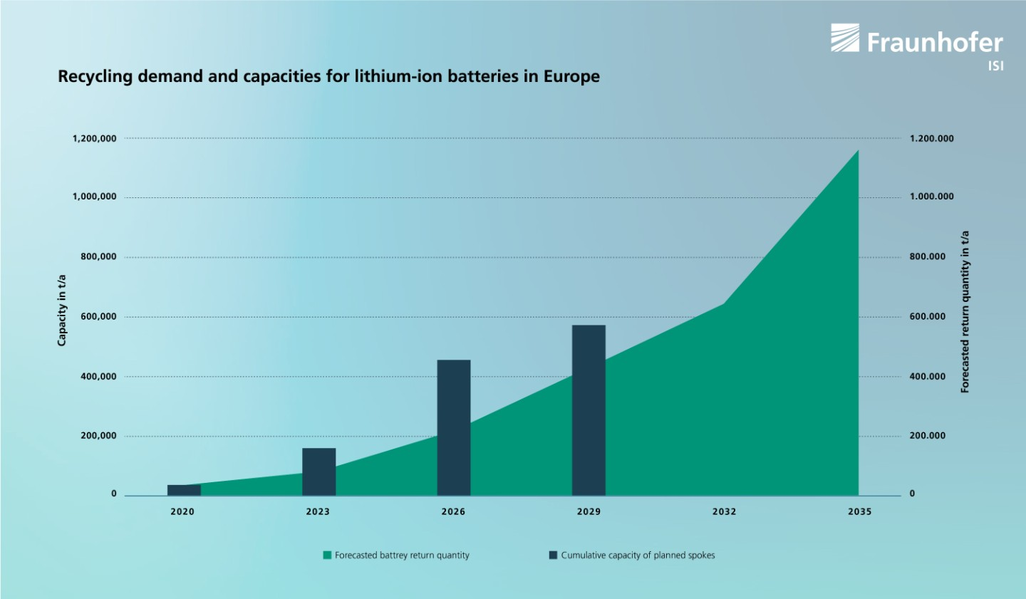

Slide 16
Growing Importance of Battery Recycling
The Frauenhofer ISI (Schmaltz, 2023) states, innovative start-ups and new industry entrants struggle with integration in LiB- Value chains due to a lack of visibility and access to:
Collection networks
Logistics partners
OEMs and cell manufacturers
Recycling facilities
Regulatory and compliance support
Notes:
Your platform could bridge this gap by making these connections transparent and accessible.

Slide 17
"The academic and policy worlds agree: visibility is the foundation of a functioning circular battery economy.
raceability prevents ethical violations and resource losses.
Visibility enables:
40% GHG reduction through efficient recycling (Stanford, 2024)
20–30% reduction in transaction costs (Anissa & Agrawal, 2022)
Second-life battery use of +5 years with state-of-health tracking

Slide 18
Business Model->Revenue Streams
Membership Fees from verified companies.
Compliance Support Packages for non-compliant businesses.
Institutional Licenses for public agencies that want to use the data for monitoring and reporting.

Slide 19

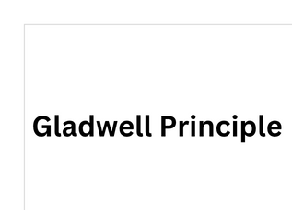

Slide 20
3. Scalability
The platform starts with a geographic focus (e.g. the Netherlands or EU), but the model is replicable globally.
As more stakeholders join, network effects increase value (for both businesses and users).

